Slide 1
FESTFLOW.
COLLEGE EVENT MANAGEMENT SYSTEM
One platform for campus events — from discovery and registration to club operations and oversight.
DISCOVER
REGISTER
MANAGE
DATABASE MANAGEMENT SYSTEMS PROJECT
S Sathyan · 25BCE1683
S Sarvesh · 25BCE1702
N Sriram · 25BCE1619
A connected campus experience
Faculty Supervisor Dr. Geetha S
VIT Chennai
FESTFLOW / COLLEGE EVENT MANAGEMENT

Slide 2
01 / THE PROBLEM
CONTEXT
Campus events are still managed in fragments
FestFlow brings the key workflows into one role-aware application.
BEFORE / DISCONNECTED
THE GAP
FESTFLOW / ONE PLATFORM
Event discovery in one place.
Registrations in another.
Club operations handled separately.
Financial records and follow-ups spread across tools.
Students need a clear way to discover and join events.
Clubs need tools to publish and operate events.
Faculty need scoped oversight.
Administrators need campus-wide visibility.
Event discovery + registration
Digital passes and certificates
Club and faculty governance
Finance, catering and sponsorship
Extended event modules
The goal is not just to list events — it is to connect the people, permissions and operations behind them.
FESTFLOW / COLLEGE EVENT MANAGEMENT
02

Slide 3
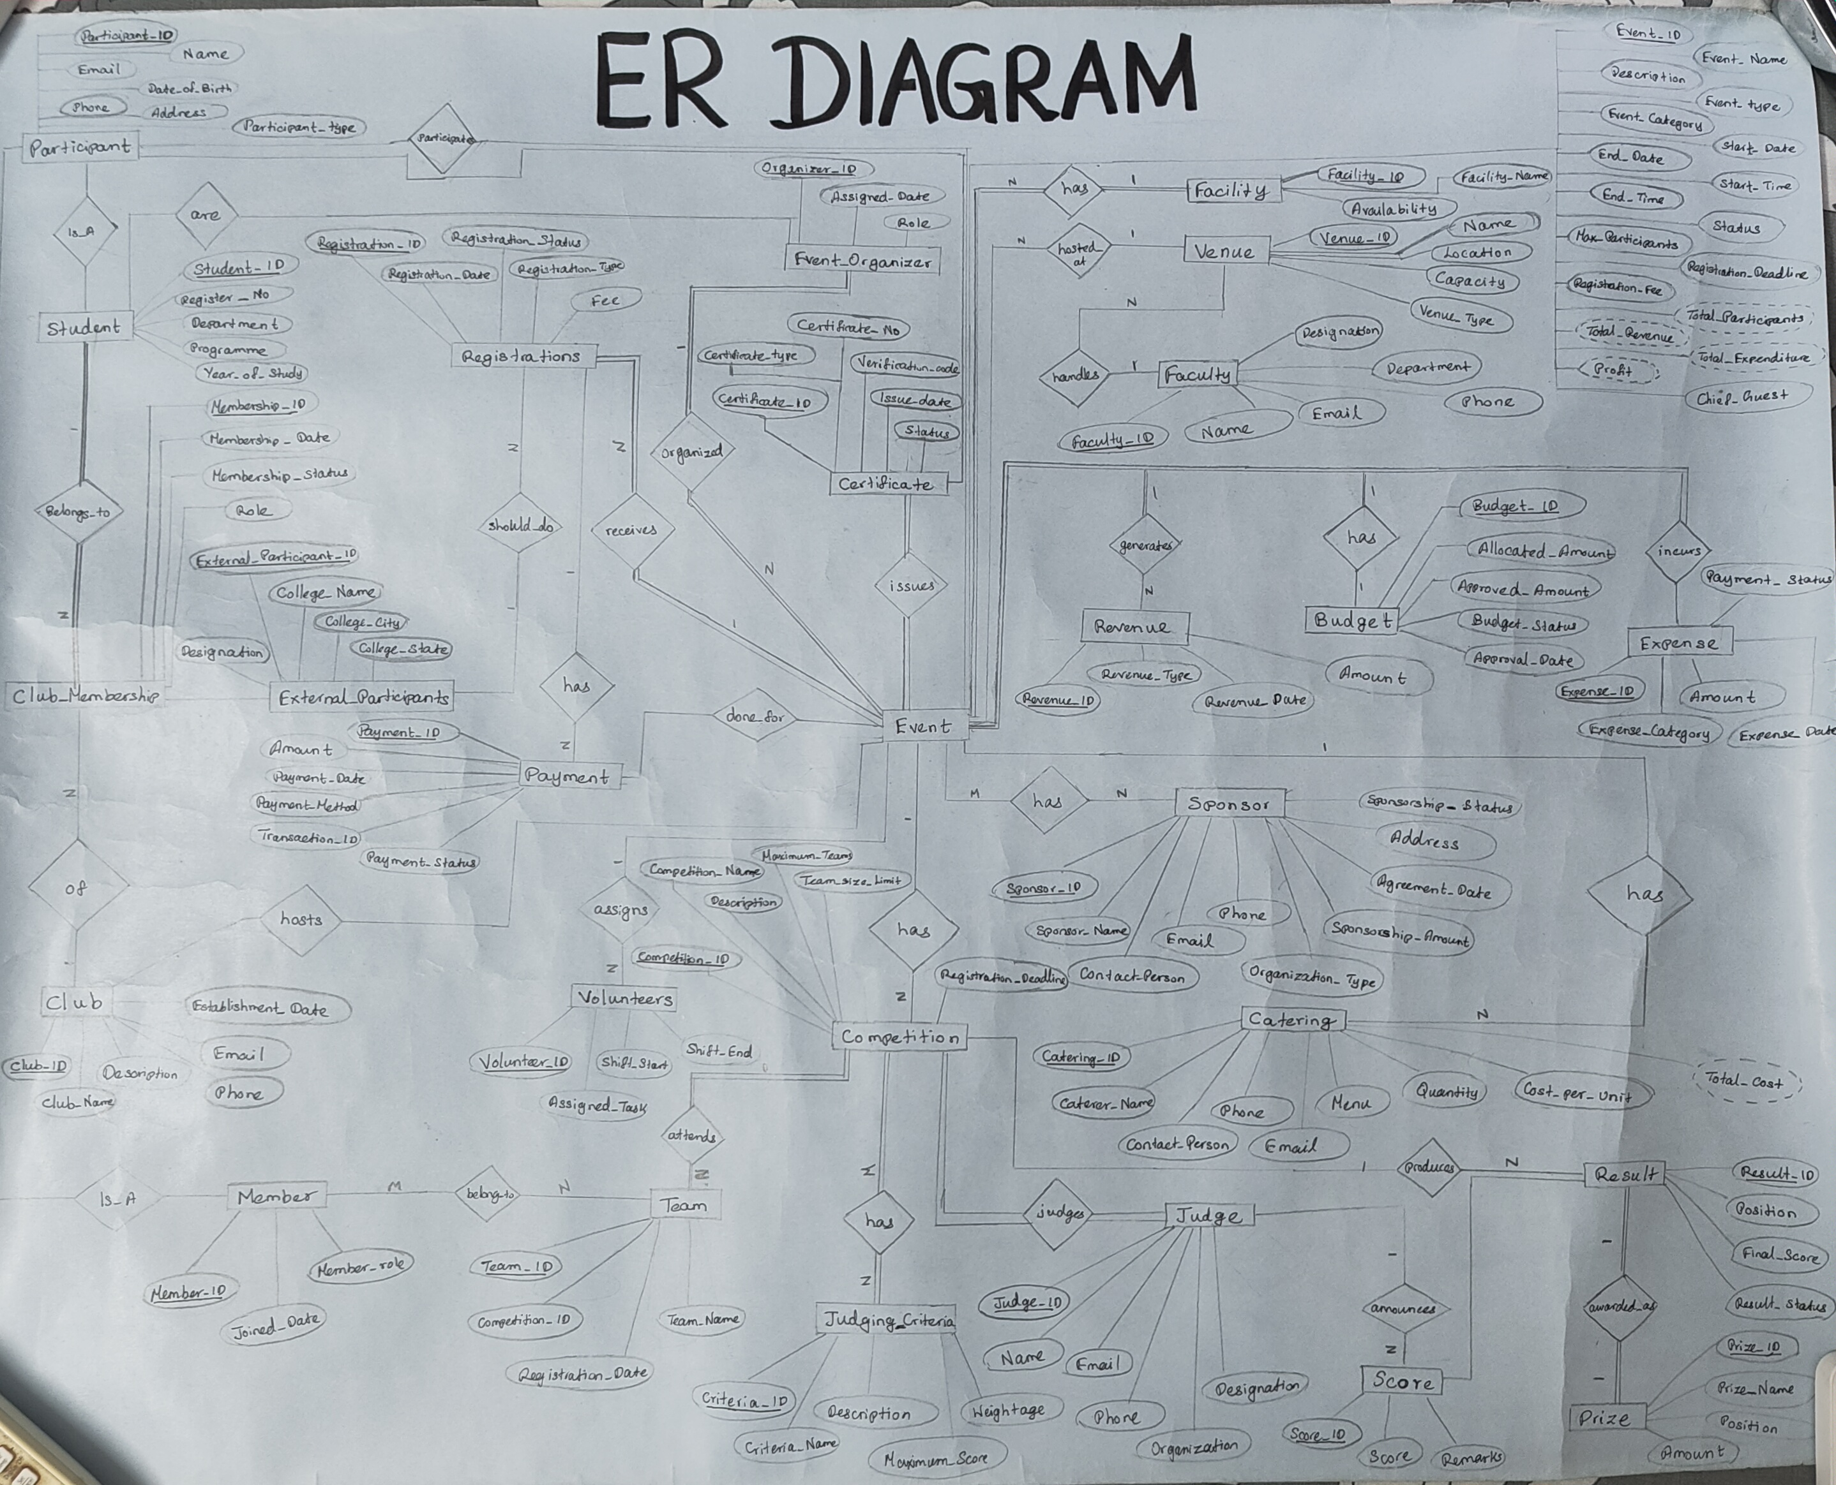
0Building of the Database
CONTEXT
ER Diagram:
FESTFLOW / COLLEGE EVENT MANAGEMENT

Slide 4
02 / TEAM OWNERSHIP
TEAM
Three areas of ownership. One integrated build.
Each member focused on a primary layer, with shared integration and review.
S SATHYAN · 25BCE1683
S SARVESH · 25BCE1702
N SRIRAM · 25BCE1619
BACKEND & API DEVELOPMENT
Node.js · Express.js
REST API routes and controllers
Middleware, authentication and authorization
Backend workflow and integration
FRONTEND & UI DEVELOPMENT
React · Vite · React Router
Axios API communication
Tailwind CSS interface
Role-based pages and user workflows
DATABASE, SECURITY & TESTING
MongoDB Atlas · Mongoose
Collections, models and references
Data integrity and access-control checks
Backend test validation
SHARED CONTRIBUTION
Requirements understanding · AI-assisted development with Antigravity · Integration · Review · Demo preparation
FESTFLOW / COLLEGE EVENT MANAGEMENT
03

Slide 5
03 / SATHYAN'S AREA
BACKEND
Backend — the request and permission layer
Node.js and Express.js coordinate API requests, validation and server-side access control.
RUNTIME
API FRAMEWORK
REQUEST FLOW
Node.js
Handles incoming requests and executes backend logic.
Express.js
Organises routes, middleware and controllers.
REST endpoints
Route → middleware → controller → model → response.
WHAT THE BACKEND IS RESPONSIBLE FOR
Authenticating users before protected operations
Checking role and club-level permissions on the server
Applying event, registration and finance business rules
Returning structured responses to the frontend
The interface can hide unavailable actions, but the backend is what actually enforces access.
FESTFLOW / COLLEGE EVENT MANAGEMENT
04

Slide 6
04 / SARVESH'S AREA
FRONTEND
Frontend — the experience people interact with
React-based pages provide the interface for students, organizers, faculty and administrators.
REACT + VITE
REACT ROUTER
AXIOS + TAILWIND
Component-based UI with a fast development and production build workflow.
Navigation between role-specific pages and application workflows.
API communication and consistent interface styling.
FRONTEND WORKFLOWS
Sign in and access the appropriate role-based workspace
Discover events, view details and register
Manage club events, registrations and operations
View passes, certificates and other event-related information
The frontend presents the experience; permissions and sensitive decisions remain enforced by the backend.
FESTFLOW / COLLEGE EVENT MANAGEMENT
05

Slide 7
05 / SRIRAM'S AREA
DATABASE
Database — structured records with meaningful links
MongoDB Atlas is the live database, accessed through Mongoose models.
18
14
ObjectId
Indexes
Collections
Mongoose model files
Document references
Uniqueness & query support
CORE ENTITIES
EVENT EXTENSIONS
INTEGRITY & QUERYING
Users · Clubs · Events
Registrations · Venues
Budgets · Expenses · Revenues
Catering · Competitions · Teams
Judges · Scores · Results
Certificates · Feedback · Volunteers · Sponsors
Schema validation
ObjectId relationships
Compound unique indexes
Aggregation pipelines
SQL files in the repository are academic reference artefacts; MongoDB Atlas is the application's runtime database.
FESTFLOW / COLLEGE EVENT MANAGEMENT
06

Slide 8
06 / END-TO-END FLOW
ARCHITECTURE
One registration request crosses all three layers
Example: a student selects an event and presses Register.
01
02
03
04
05
06
07
08
React UI
→
Axios
→
Express API
→
JWT + role checks
→
Controller
→
Mongoose
→
MongoDB Atlas
→
Response
Student action
HTTP request
Route + middleware
Authenticate + authorize
Apply business rules
Validate + query
Read / write record
Update the UI
WHY THIS MATTERS
A successful registration is more than a button click: it requires authentication, permission checks, data validation and a persisted record.
The same layered pattern supports event management, club governance and financial operations.
FESTFLOW / COLLEGE EVENT MANAGEMENT
07

Slide 9
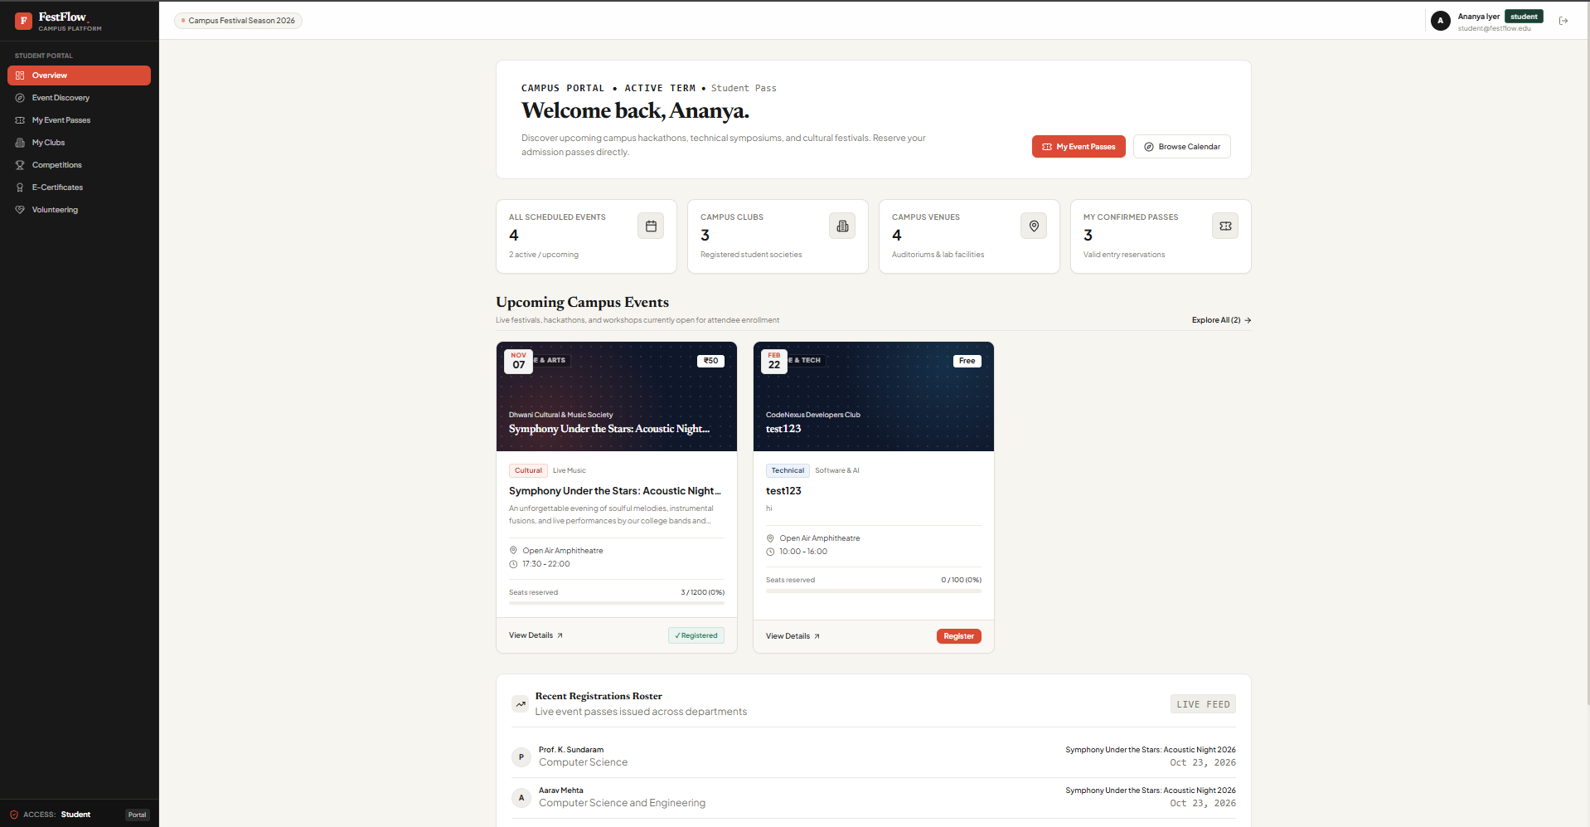
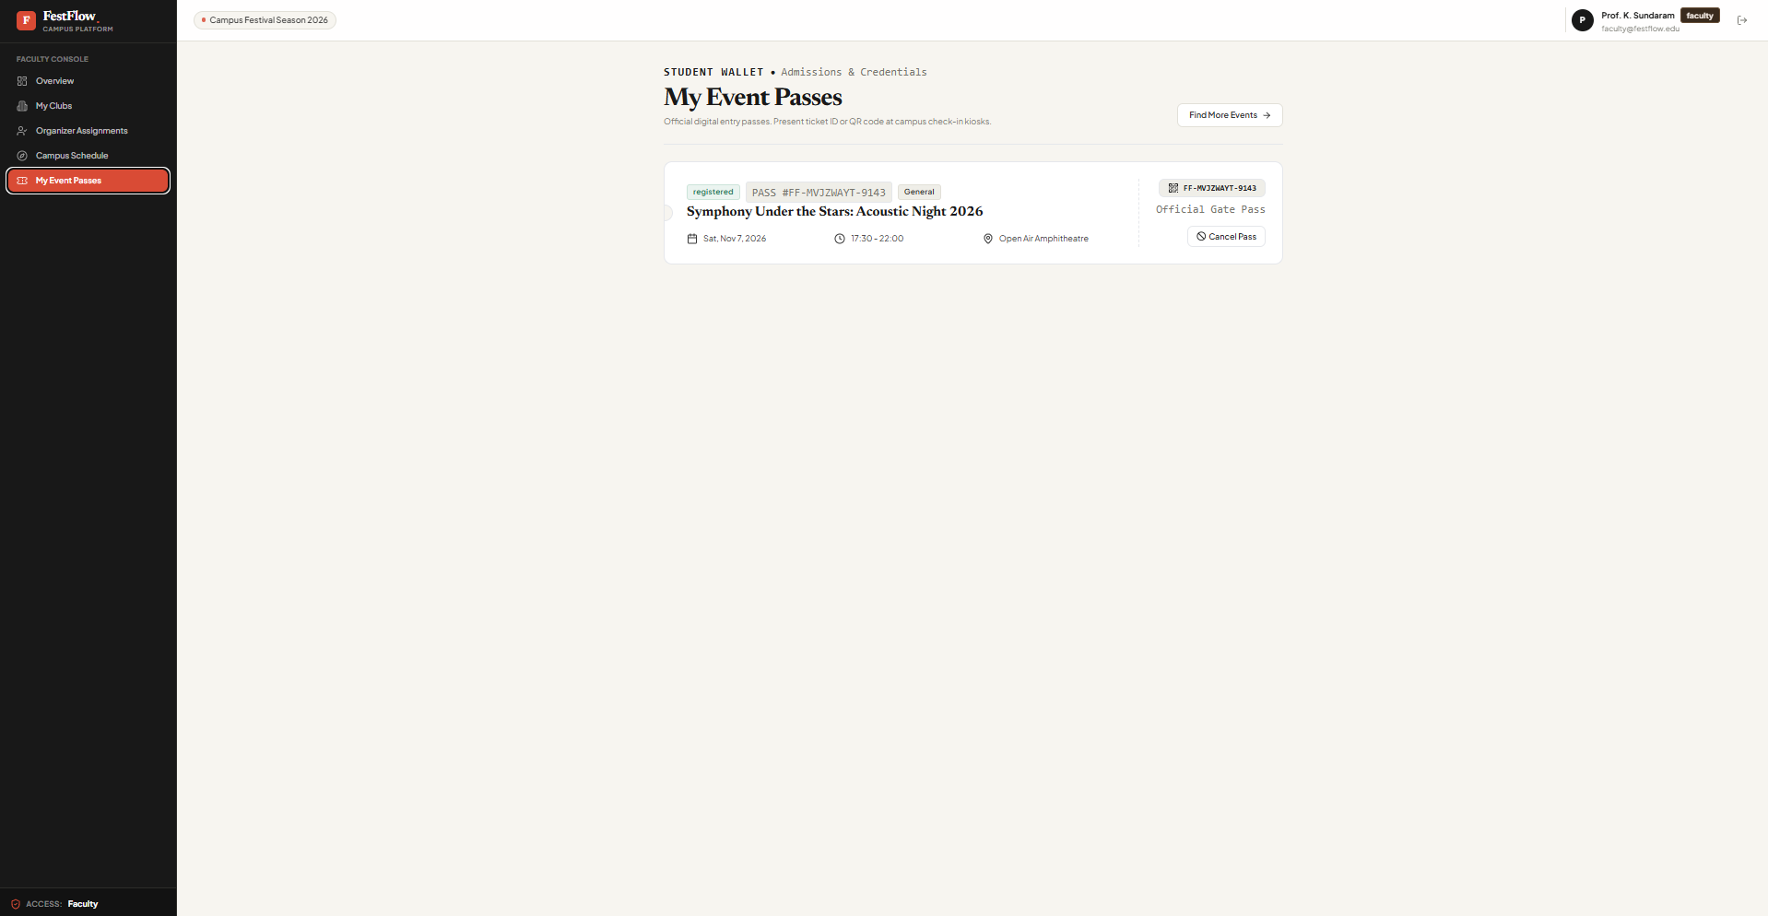
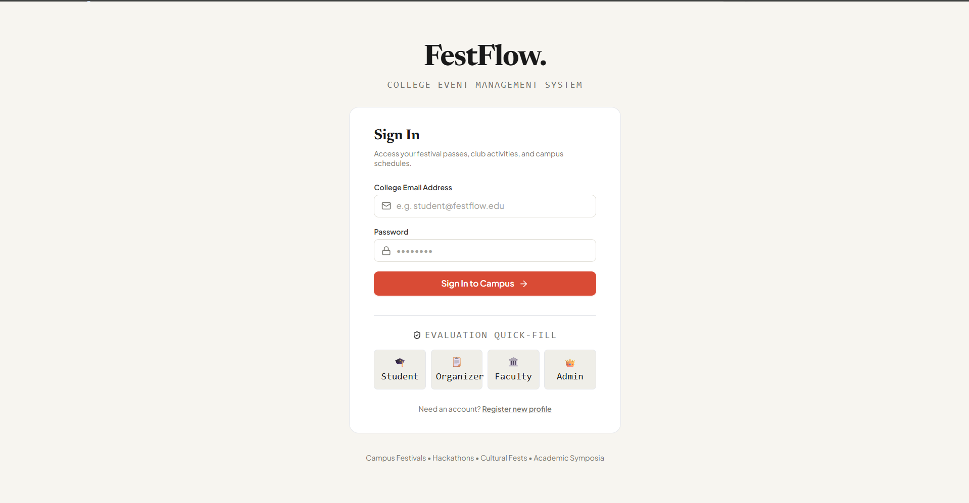
07 / APPLICATION OUTPUT
PRODUCT
The student experience
From signing in to discovering events and accessing event-related information.
SIGN IN
EVENT DISCOVERY
MY EVENT PASSES
Role-based entry · Browse campus activities · Keep track of registrations
FESTFLOW / COLLEGE EVENT MANAGEMENT
08

Slide 10
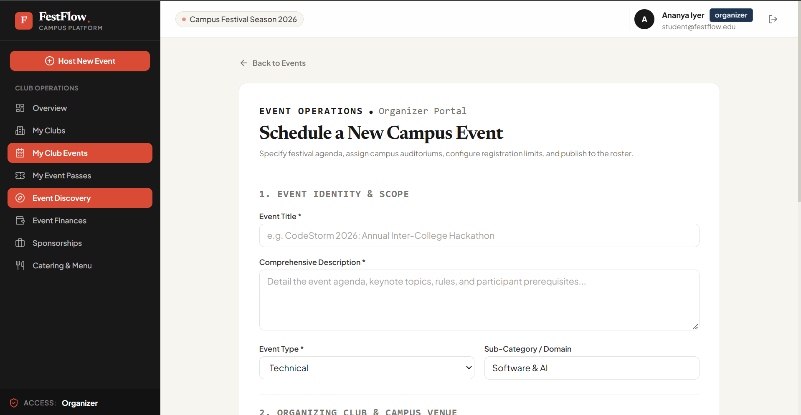
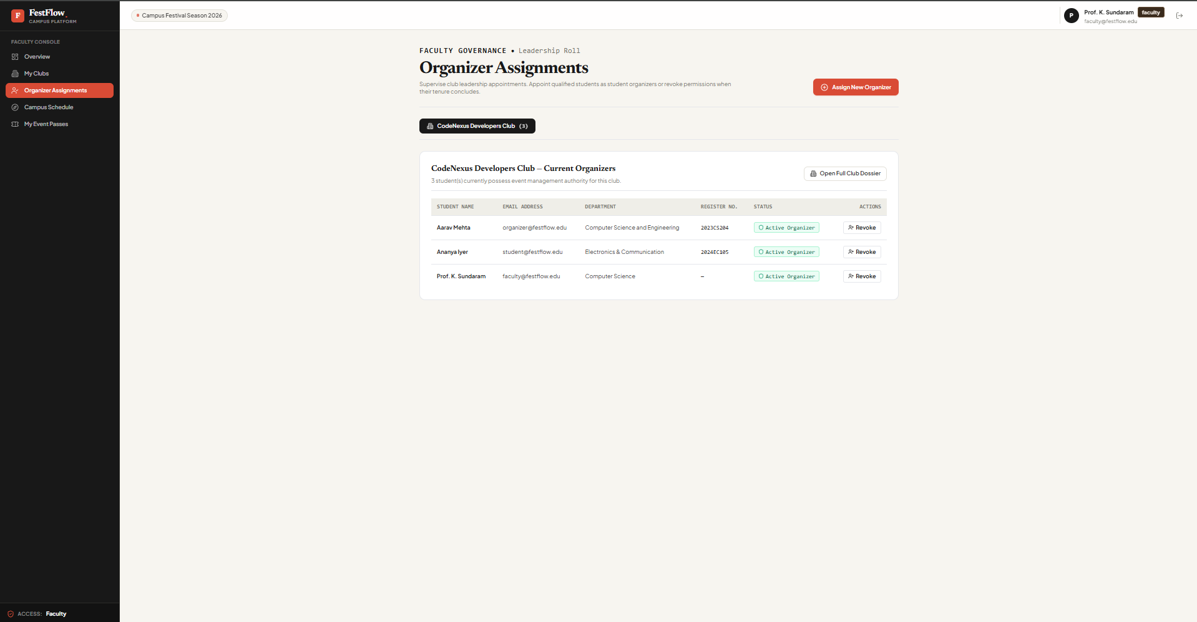
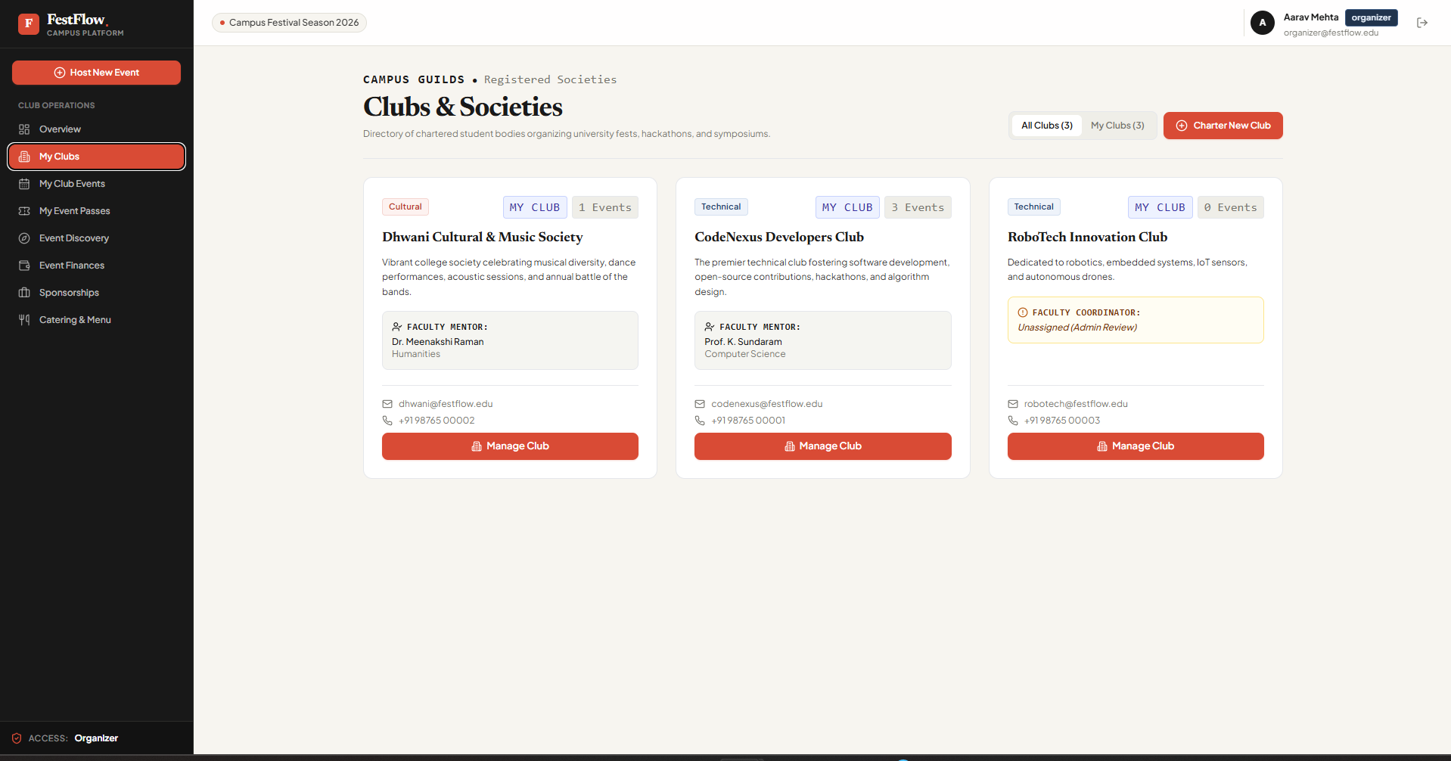
08 / APPLICATION OUTPUT
PRODUCT
Managing campus events and clubs
Organizers manage their assigned clubs while faculty supervise the clubs under their responsibility.
CREATE / EDIT EVENTS
ORGANIZER ASSIGNMENTS
CLUBS & SOCIETIES
Club-scoped permissions are checked on the server, not just reflected in the page layout.
FESTFLOW / COLLEGE EVENT MANAGEMENT
09

Slide 11
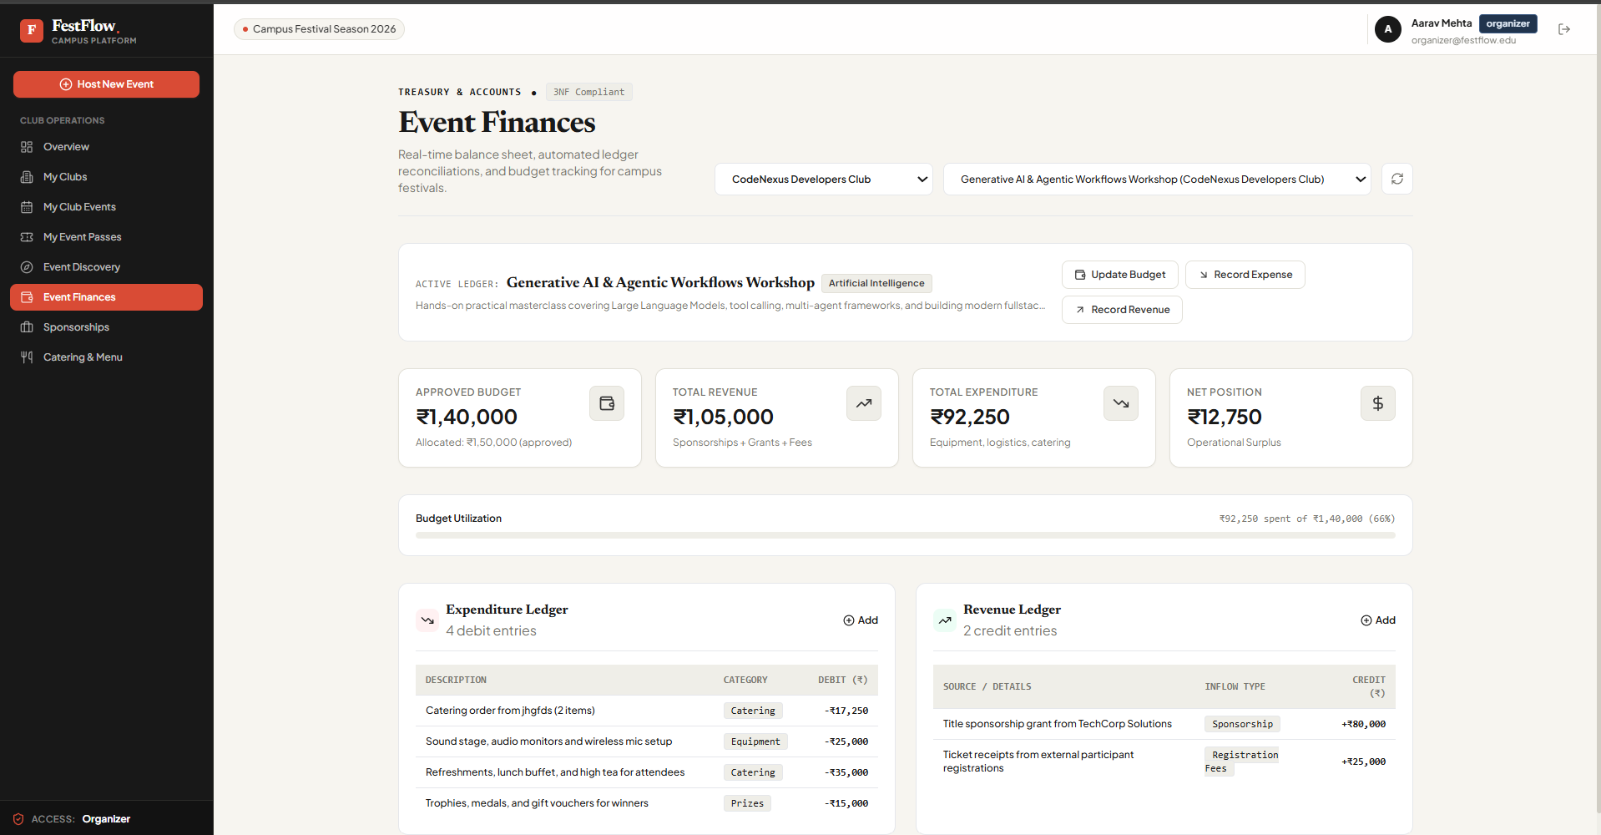
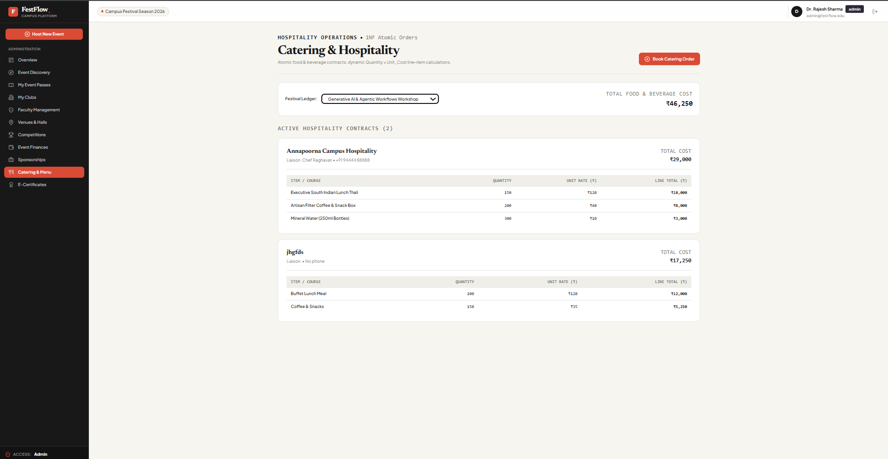
09 / APPLICATION OUTPUT
PRODUCT
Beyond registration — running the event
Operational modules help clubs manage the practical work around campus events.
EVENT FINANCES
CATERING & HOSPITALITY
Budgets · Expenses · Revenue summaries Catering quantities · Orders · Derived costs
FESTFLOW / COLLEGE EVENT MANAGEMENT
10

Slide 12
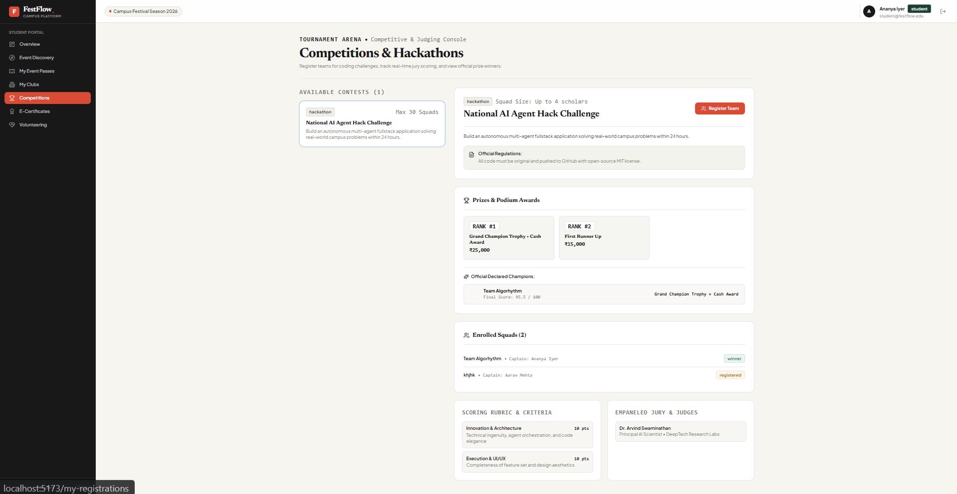
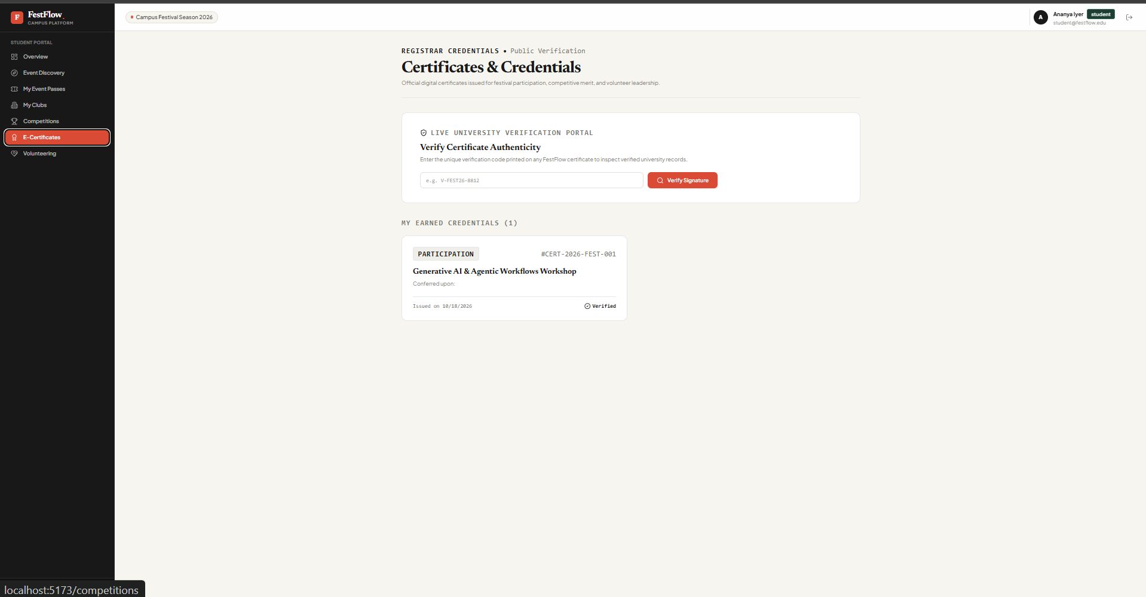
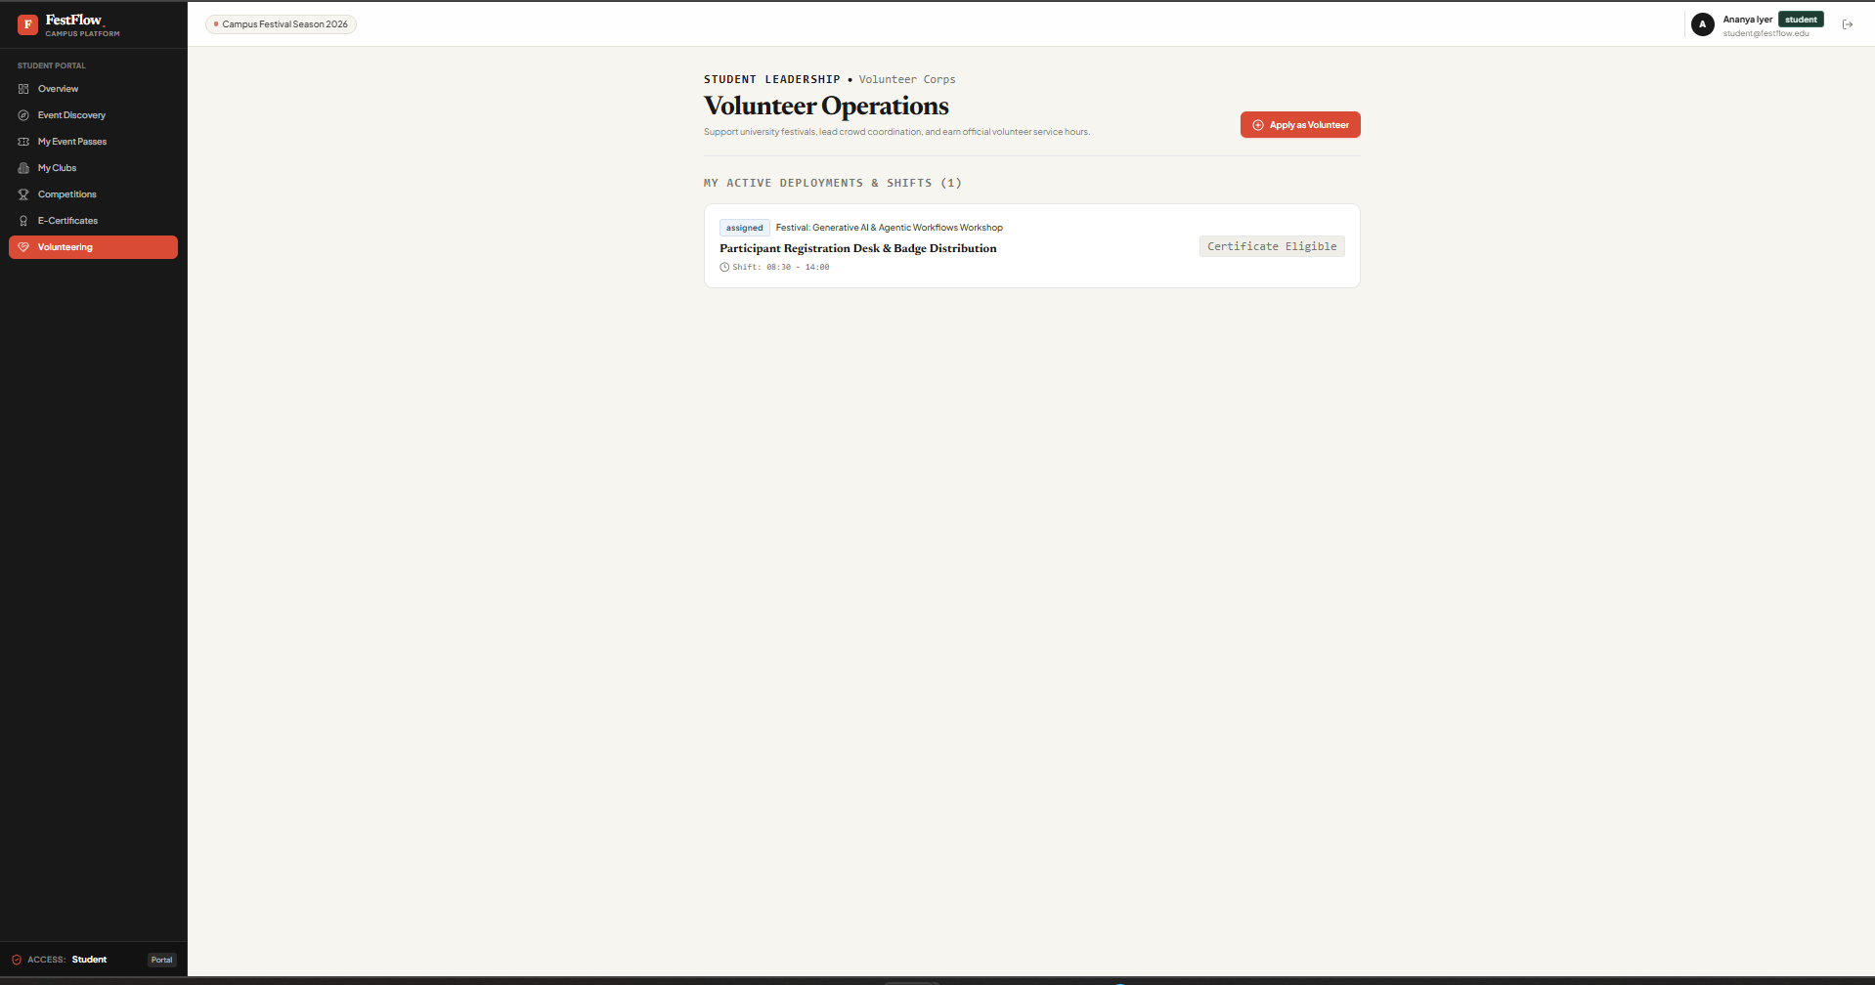
10 / APPLICATION OUTPUT
PRODUCT
One platform for multiple campus activities
Additional modules build on the same event, user and authorization foundations.
COMPETITIONS
CERTIFICATES
VOLUNTEER OPERATIONS
Team participation · judging and results · certificate access and verification · volunteer coordination
FESTFLOW / COLLEGE EVENT MANAGEMENT
11

Slide 13
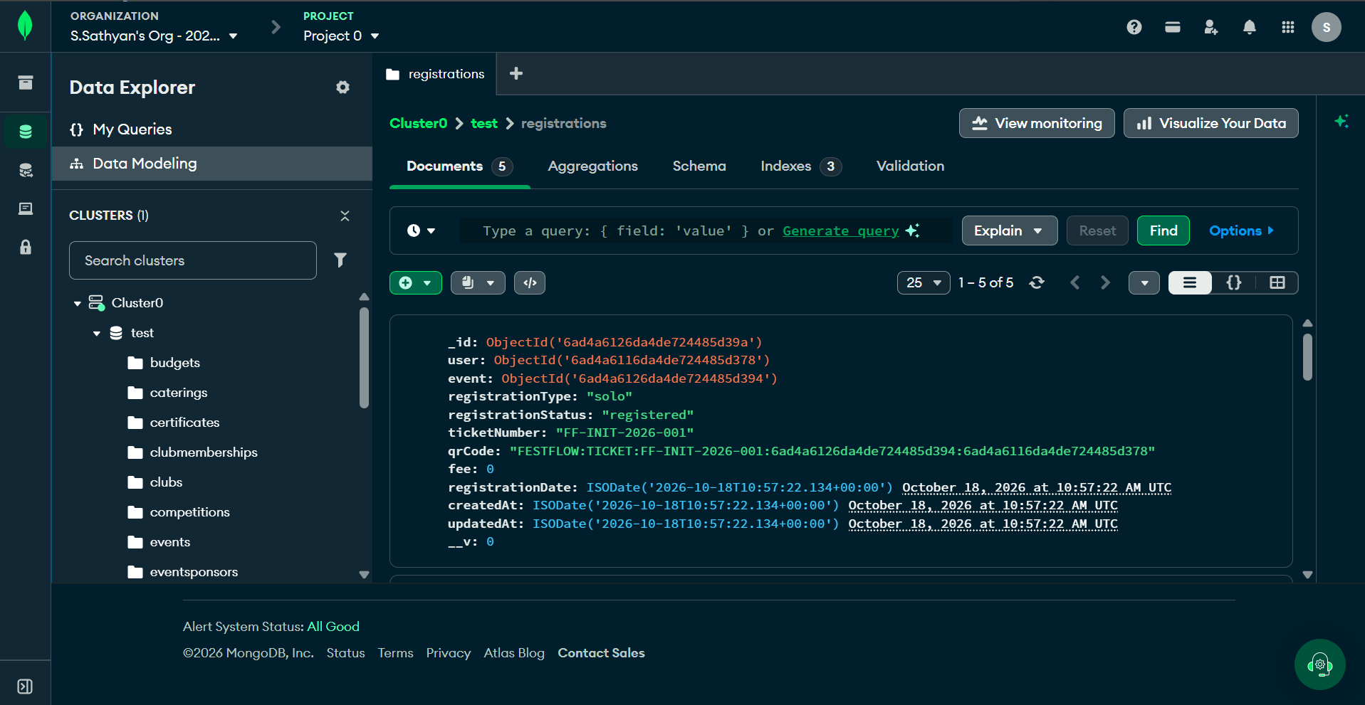
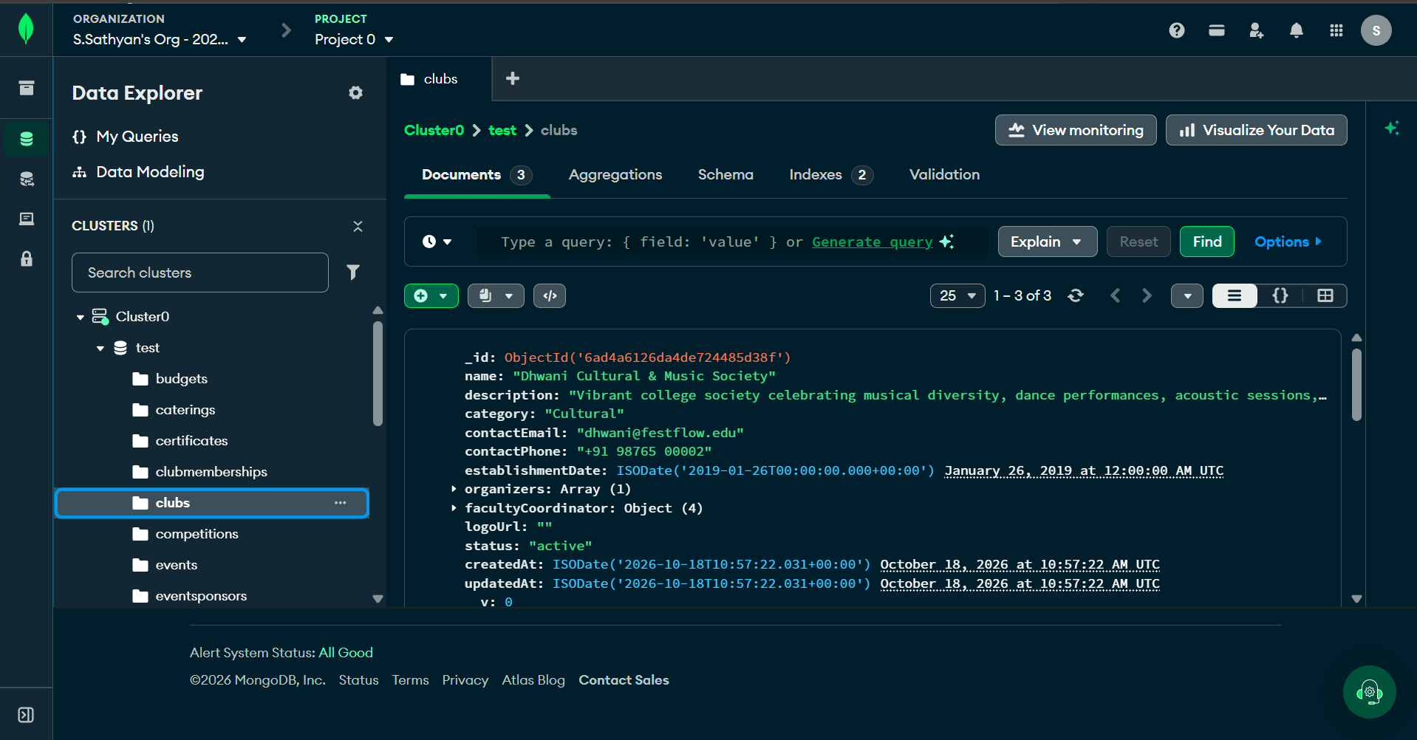
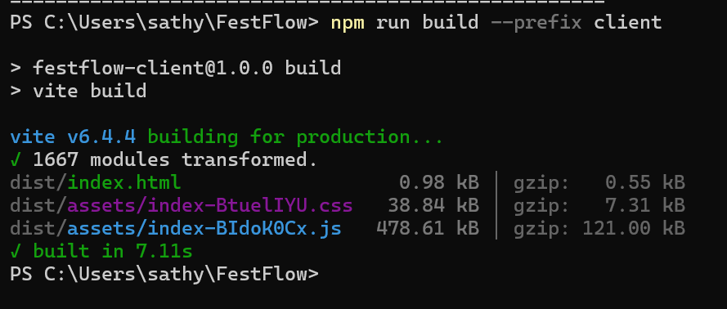
11 / EVIDENCE
VERIFICATION
Data in Atlas. Permissions tested. Build verified.
A few snapshots of the underlying database and the verification runs.
REGISTRATION RECORDS
CLUB DATA
PRODUCTION BUILD
22 / 22
17 / 17
14 modules
Faculty & club tests passed
Multi-club permission tests passed
Backend integration suite verified
Frontend production build: 1,667 modules transformed. These are separate verification results, not a single combined test count.
FESTFLOW / COLLEGE EVENT MANAGEMENT
12

